Slide 1
Scope of today’s work
Existence check (CGI): testing whether a quantity really is a state function
Using the cross-integration method
Using the cross-derivative method

Slide 2
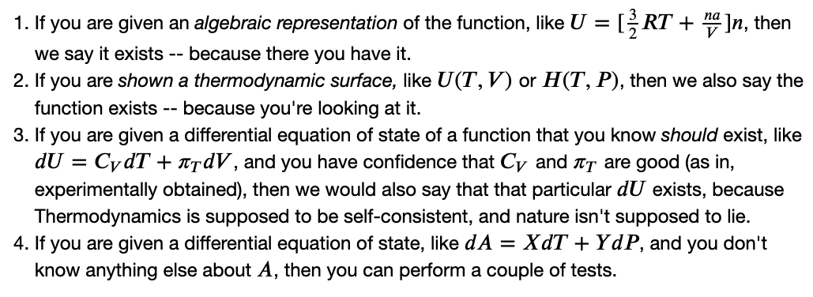
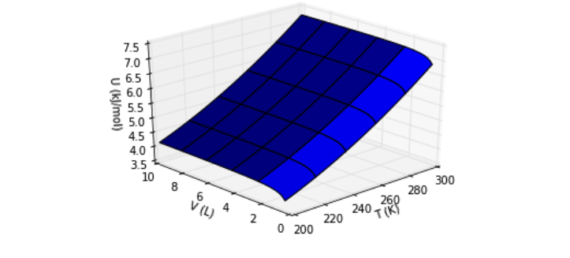
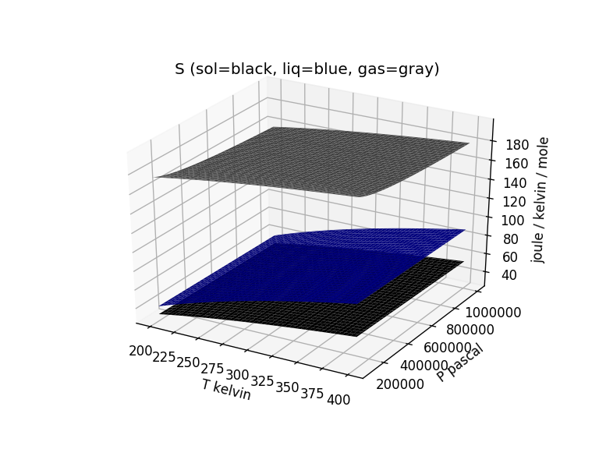
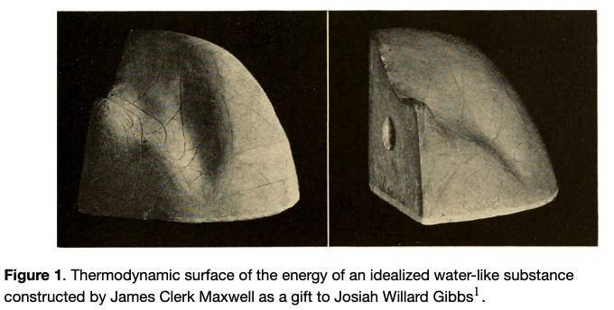
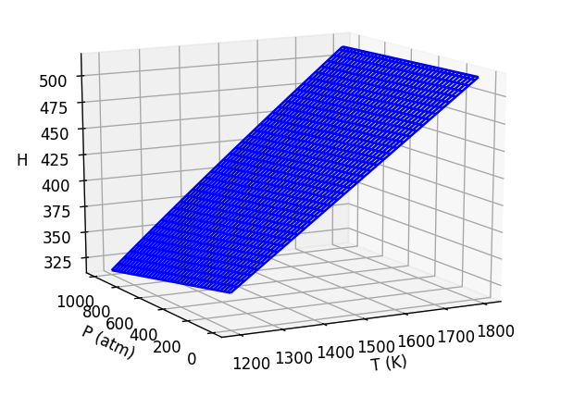



Existence check: How to tell whether a state function actually exists
$$U(T,V)$$
$$S(T,P)$$
$$H(T,P)$$

Slide 3
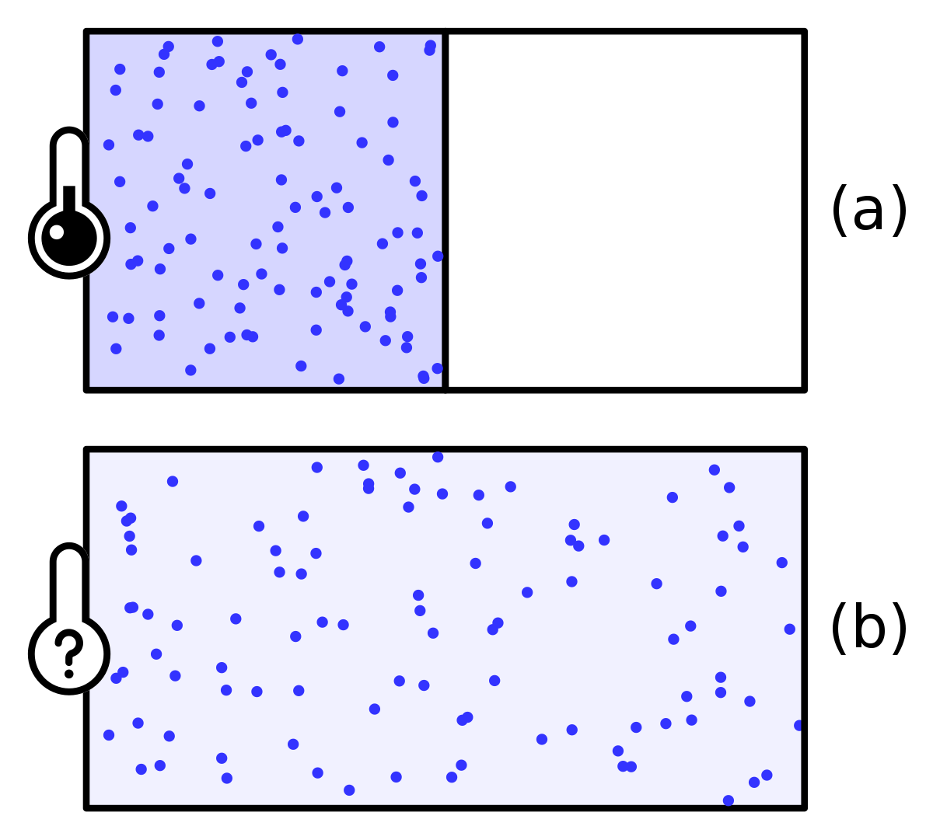

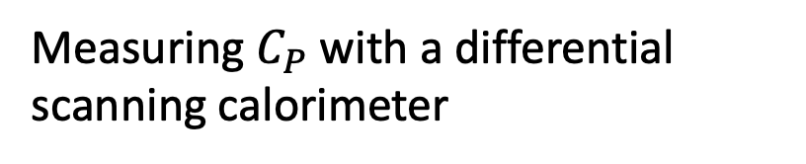

Existence check: How to tell whether a state function actually exists
Measuring $C_{P}$ with a differential scanning calorimeter
Measuring $π_{T}$

Slide 4
Existence check: How to tell whether a state function actually exists
Cross-integration test
Cross-derivative test

Slide 5
Existence check: How to tell whether a state function actually exists
Cross-integration test
Cross-derivative test

Slide 6
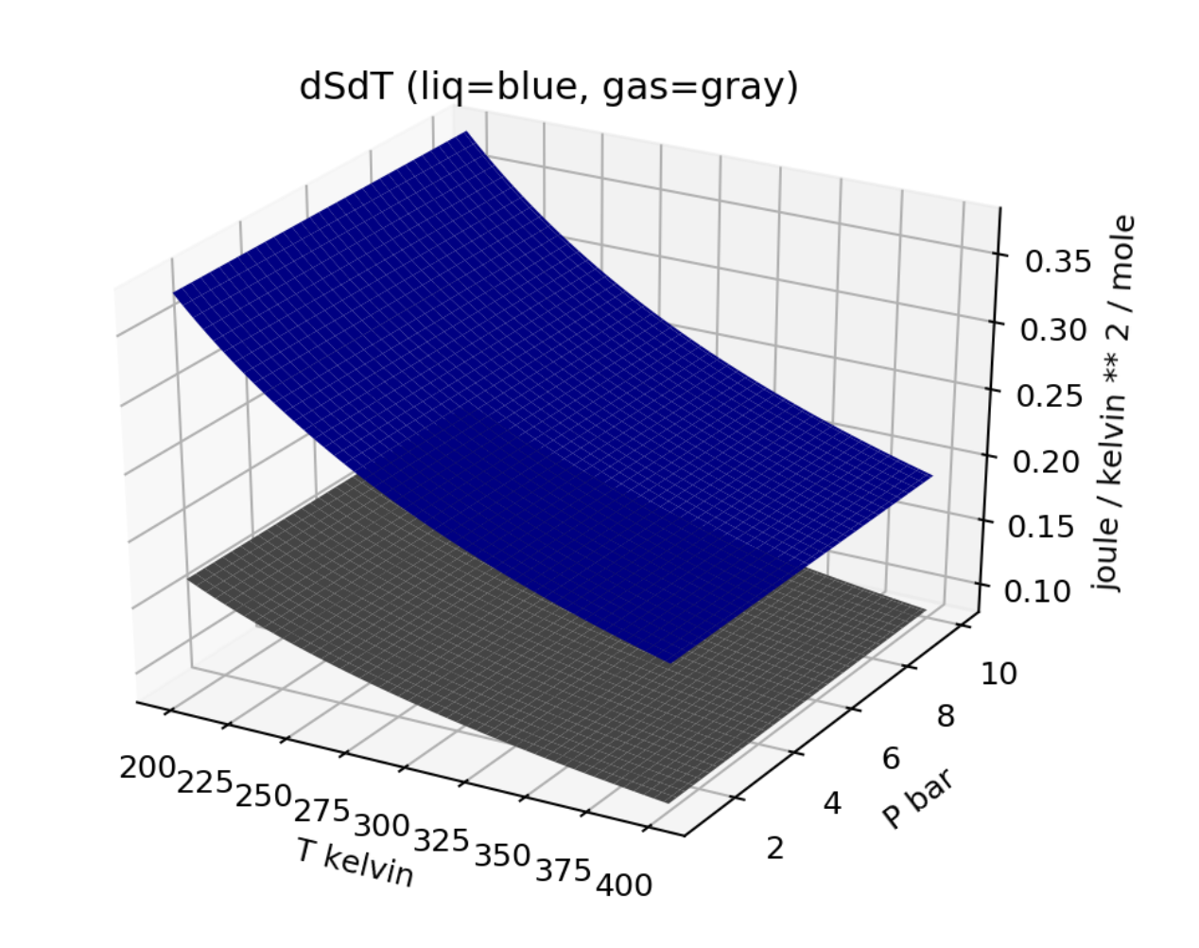
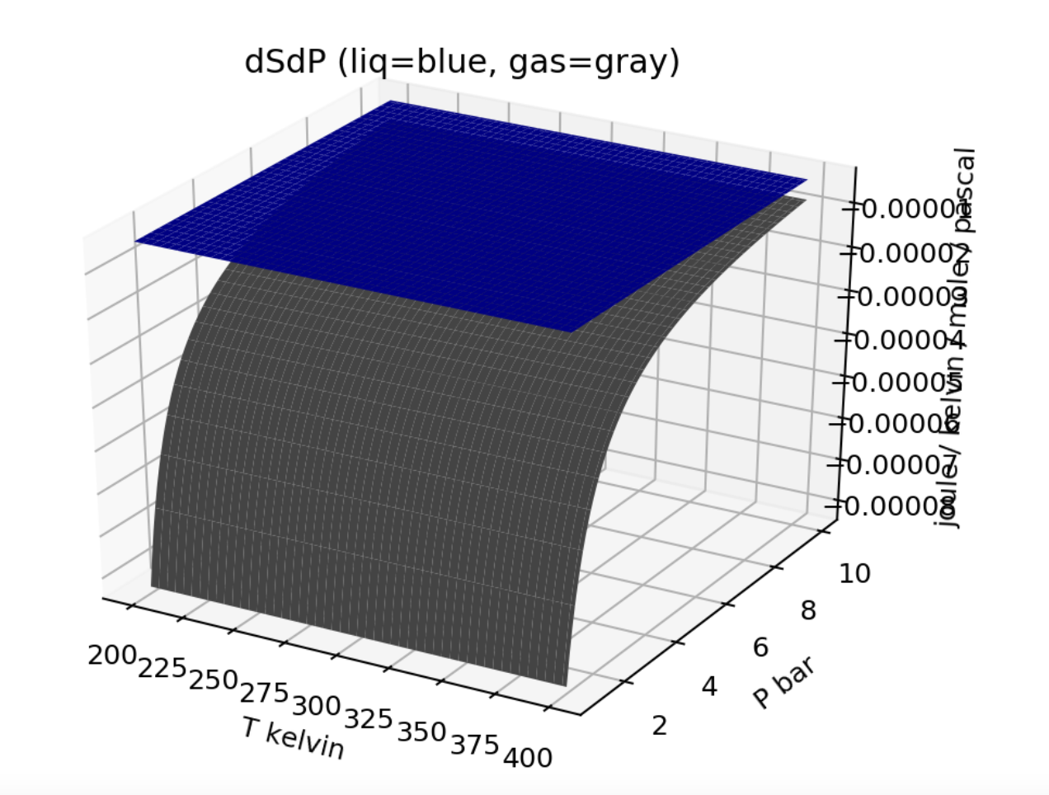

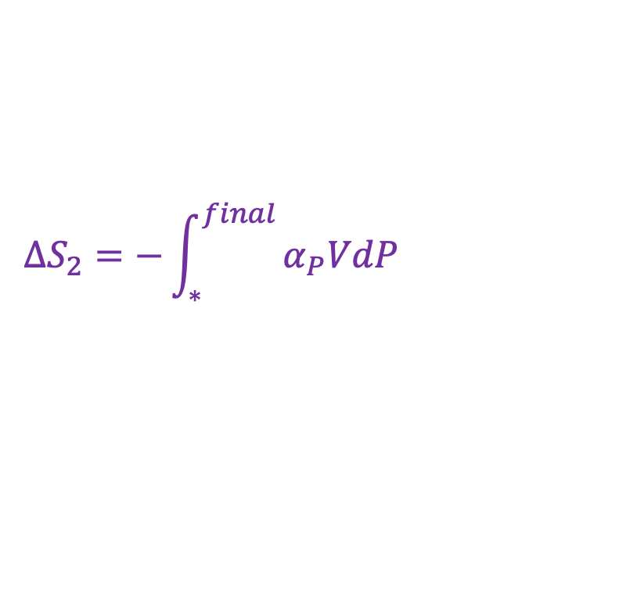
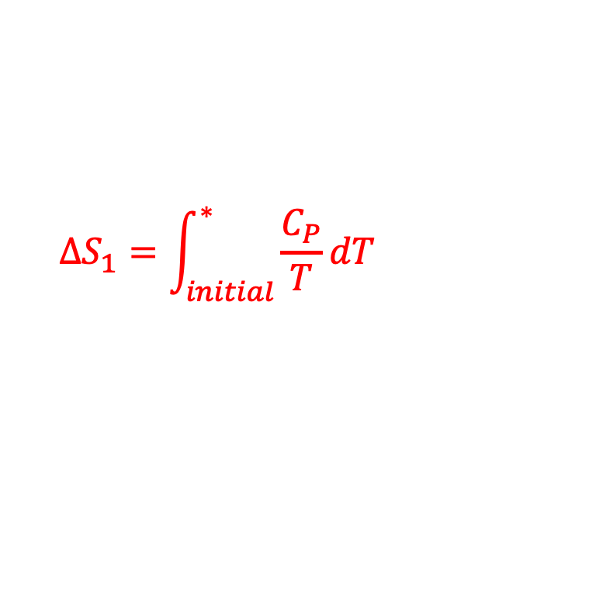
The cross-integration test for existence
*
*
$$∆S_{1}=\int_{initial}^{∗ }{\frac{C_{P}}{T}dT}$$
$$∆S_{2}=−\int_{∗}^{final }{α_{P}VdP}$$
$$∆S=$$
$$∆S_{1}+∆S_{2}$$
Integrate over temperature first, then pressure

Slide 7

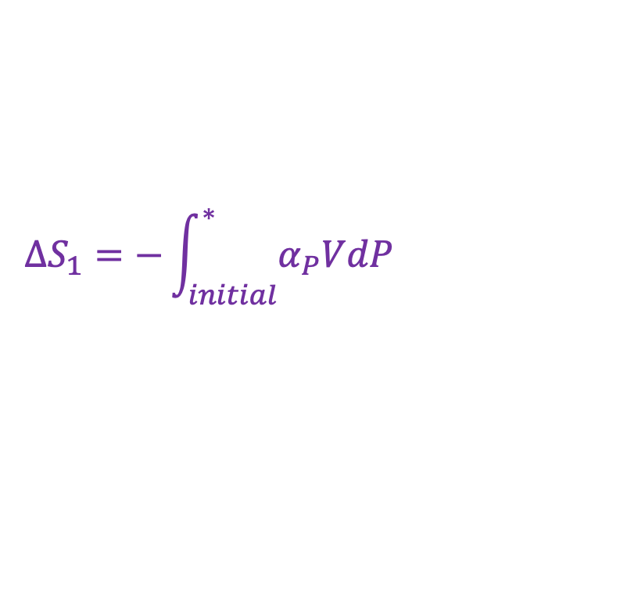
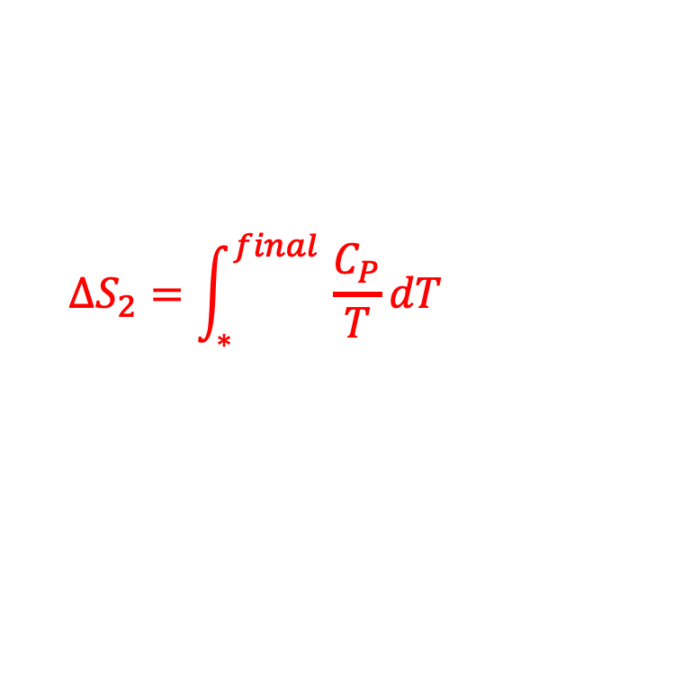
The cross-integration test for existence
$$∆S_{1}=−\int_{initial}^{∗ }{α_{P}VdP}$$
$$∆S_{2}=\int_{∗}^{final }{\frac{C_{P}}{T}dT}$$
$$∆S=$$
$$∆S_{1}+∆S_{2}$$
Or: integrate over pressure first, then temperature

Slide 8

The cross-integration test for existence
$$∆S=$$
$$∆S_{1}+∆S_{2}$$
We get the same S(T,P) regardless of the order

Slide 9
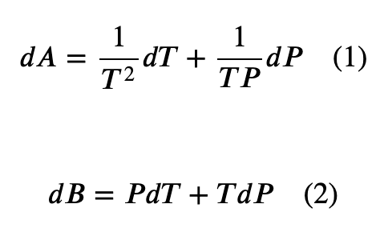
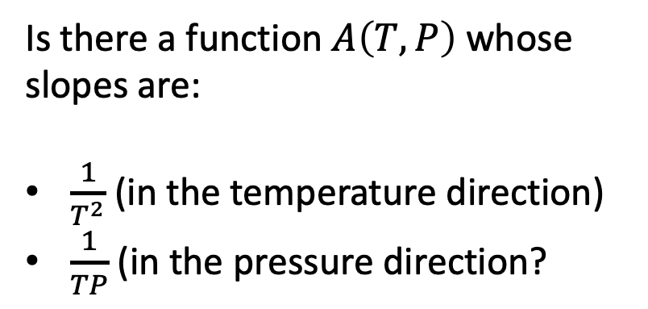
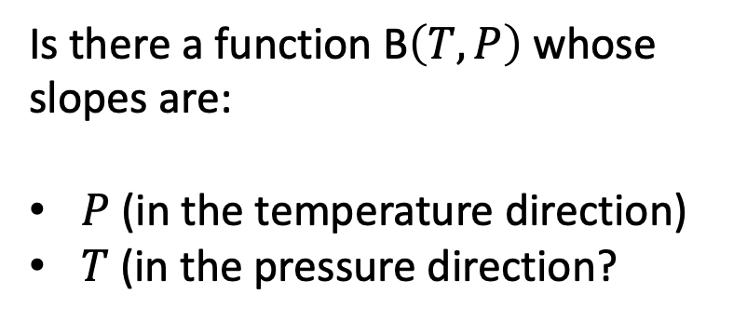
The cross-integration test for existence
Is there a function $A\left(T,P\right)$ whose slopes are:
$\frac{1}{T^{2}}$ (in the temperature direction)
$\frac{1}{TP}$ (in the pressure direction?
Is there a function B$\left(T,P\right)$ whose slopes are:
$P$ (in the temperature direction)
$T$ (in the pressure direction?

Slide 10
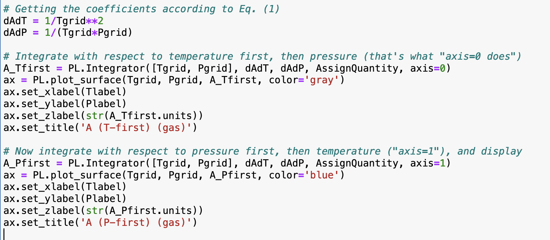
Numerical cross-integration: the Integrator

Slide 11
Numerical cross-integration: the Integrator

Slide 12
Numerical cross-integration: the Integrator

Slide 13
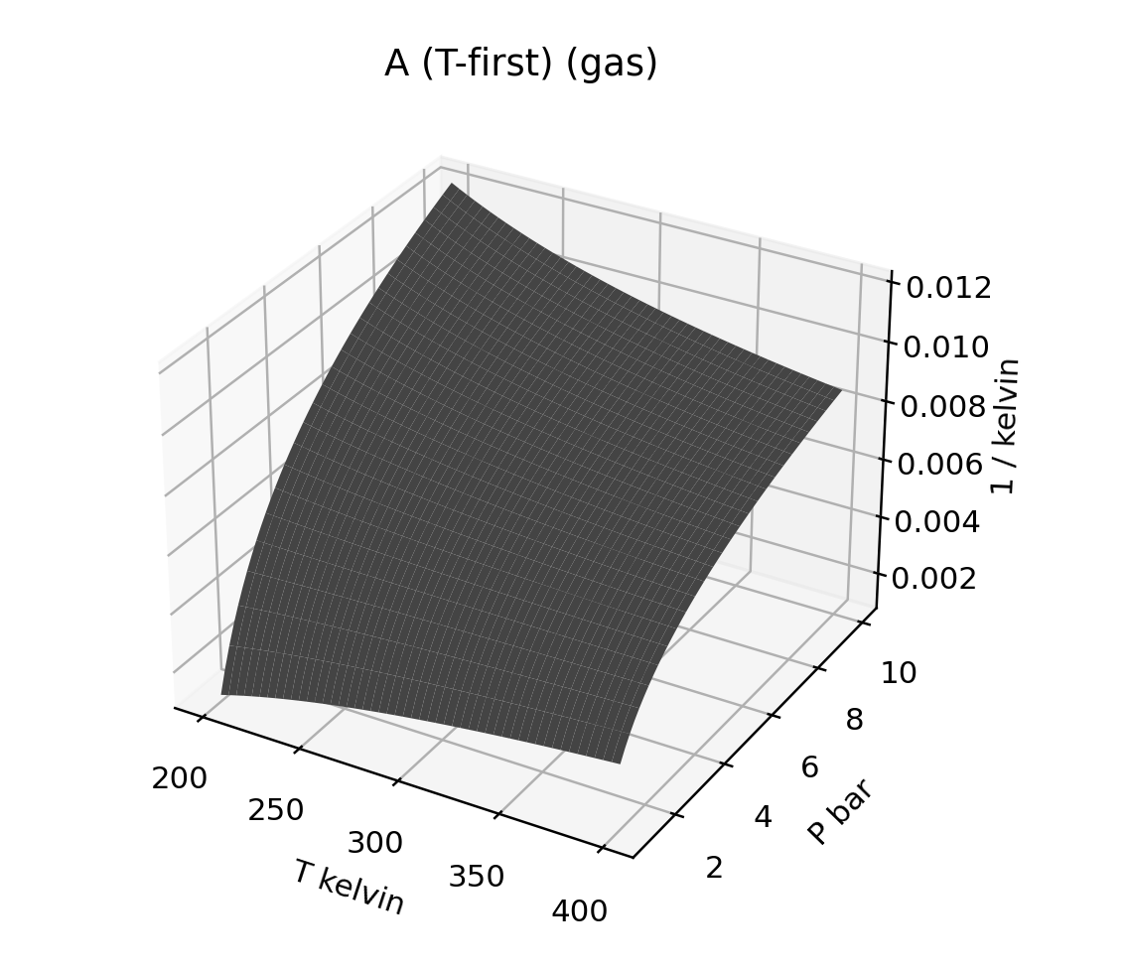
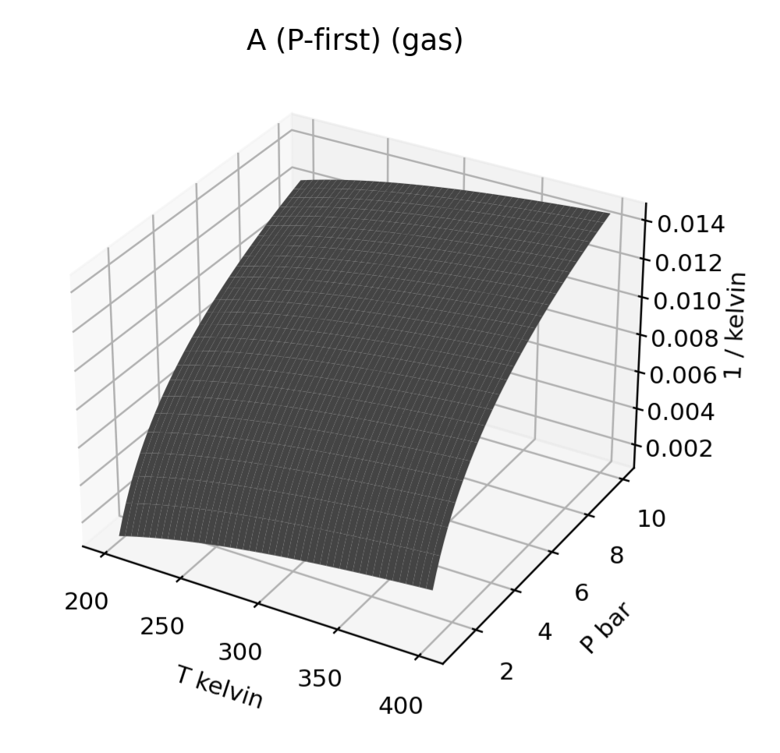
Numerical cross-integration: the Integrator

